Slide 1
UNIT-3
Applications of linked lists

Slide 2
Outcome
Able to understand and implement linked lists in real time applications.

Slide 3
Applications
Stacks
Queues
Polynomial Addition
Sparse Matrix

Slide 4
Stacks
A stack is a list of elements in which an element may be inserted or deleted only at one end, called the top of the stack.
The elements are removed from a stack in the reverse order of that in which they were inserted into the stack.
Stack is also known as a LIFO (Last in Fast out) list or Push down list.

Slide 5
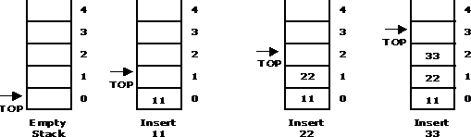
Basic Stack Operations
PUSH: It is the term used to insert an element into a stack.
PUSH operations on stack

Slide 6
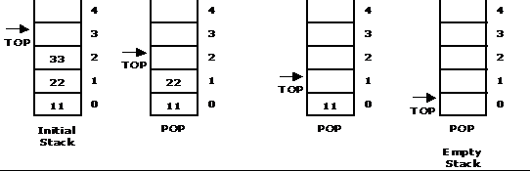
Basic Stack Operations
POP: It is the term used to delete an element from a stack.
POP operation from a stack

Slide 7
Standard Error Messages in Stack
Two standard error messages of stack are
Stack Overflow: If we attempt to add new element beyond the maximum size, we will encounter a stack overflow condition.
Stack Underflow: If we attempt to remove elements beyond the base of the stack, we will encounter a stack underflow condition.

Slide 8
Stack Operations using linked list
PUSH (start , ITEM): This procedure pushes an ITEM onto a stack. This is similar to inserting a node at the end of linked list.
void push(start,item) {
newnode=getnode();
if(start==NULL)
start=newnode;
else
{
temp=start;
while(temp!=NULL)
temp=temp->next;
temp->next=newnode;
} }

Slide 9
Stack Operations using linked list
POP (start, ITEM): This procedure deletes the top element of STACK. This operation is similar to delete a node at end of linked list
void pop(start,item){
temp=prev=start;
while(temp!=NULL){
prev=temp;
temp=temp->next;
}
prev->next=NULL;
free(temp);
}}

Slide 10
Queue
A queue is a data structure where items are inserted at one end called the rear and deleted at the other end called the front.
Another name for a queue is a ―FIFO‖ or
―First-in-first-out‖ list.
Operations of a Queue:
enqueue:which inserts an element at the end of the queue.
dequeue:which deletes an element at the front of the queue.

Slide 11
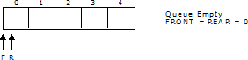
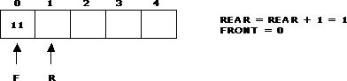
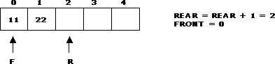
Representation of Queue
Initially the queue is empty.
Now, insert 11 to the queue. Then queue status will be:
Next, insert 22 to the queue. Then the queue status is:

Slide 12
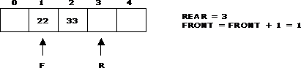
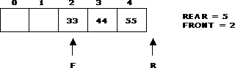
Representation of Queue
Now, delete an element 11.
Next insert another element, say 66 to the queue. We cannot insert 66 to the
queue as it signals queue is full. The queue status is as follows:

Slide 13
Queue Operations using Linked List
insertQ(): inserts an element at the end of queue Q. This operation is similar to insert a node at the end of linked list.
void insertQ(start,item) {
newnode=getnode();
if(start==NULL)
start=newnode;
else
{
temp=start;
while(temp!=NULL)
temp=temp->next;
temp->next=newnode; } }

Slide 14
Queue Operations using Linked List
deleteQ(): deletes the first element of Q. This is similar to delete a node at the begin.
deleteQ(start, item)
{
temp=start;
printf(“Deleted : %d”,temp->data);
start=start->next;
free(temp);
}

Slide 15
Sparse Matrices
Sparse matrix …
Many elements are zero means sparse matrix has very few non zero elements
• Time complexity of the matrix will be O(n^2),because the operations that are carried out on matrices need to perform on one row at a time and individual columns in that row, results in use of two nested loops.
Example: if the matrix is of size 100*100and only 10 elements are non zero. Then for accessing these 10 elements one has to make 10000 times scan.

Slide 16
Representation of sparse matrix
A sparse matrix can be represented by using TWO representations, those are as follows...
Triplet Representation (Array Representation)
In this representation, we consider only non-zero values along with their row and column index values.
Linked Representation
In linked representation, we use a linked list data structure to represent a sparse matrix.

Slide 17
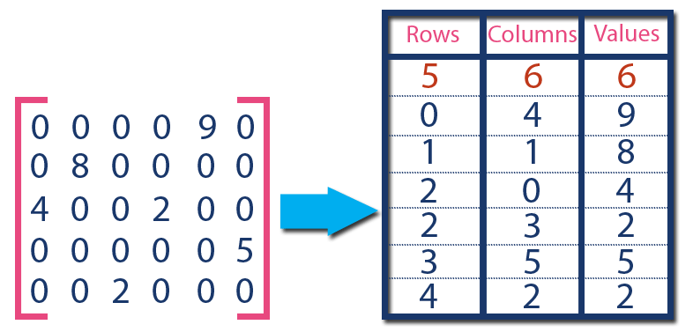
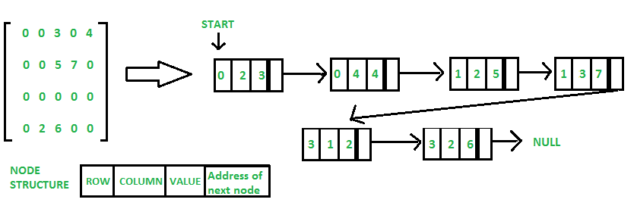

Slide 18
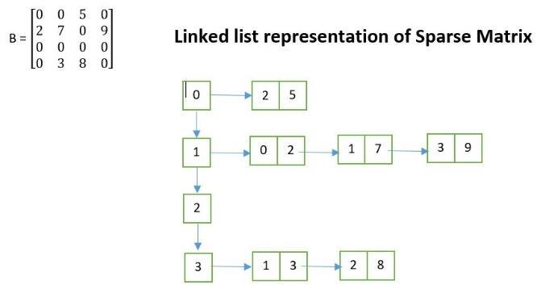

Slide 19
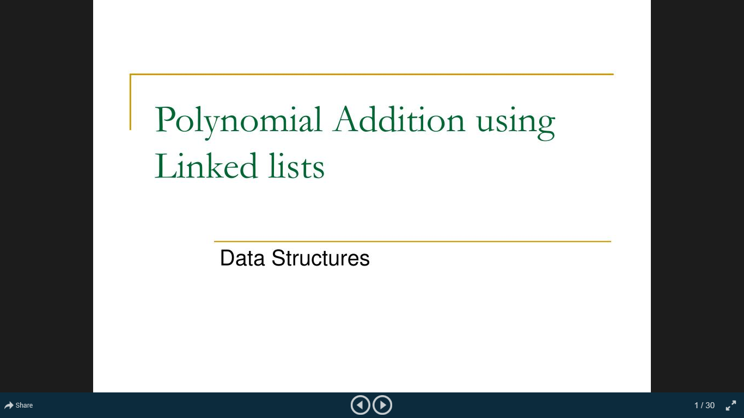

Slide 20
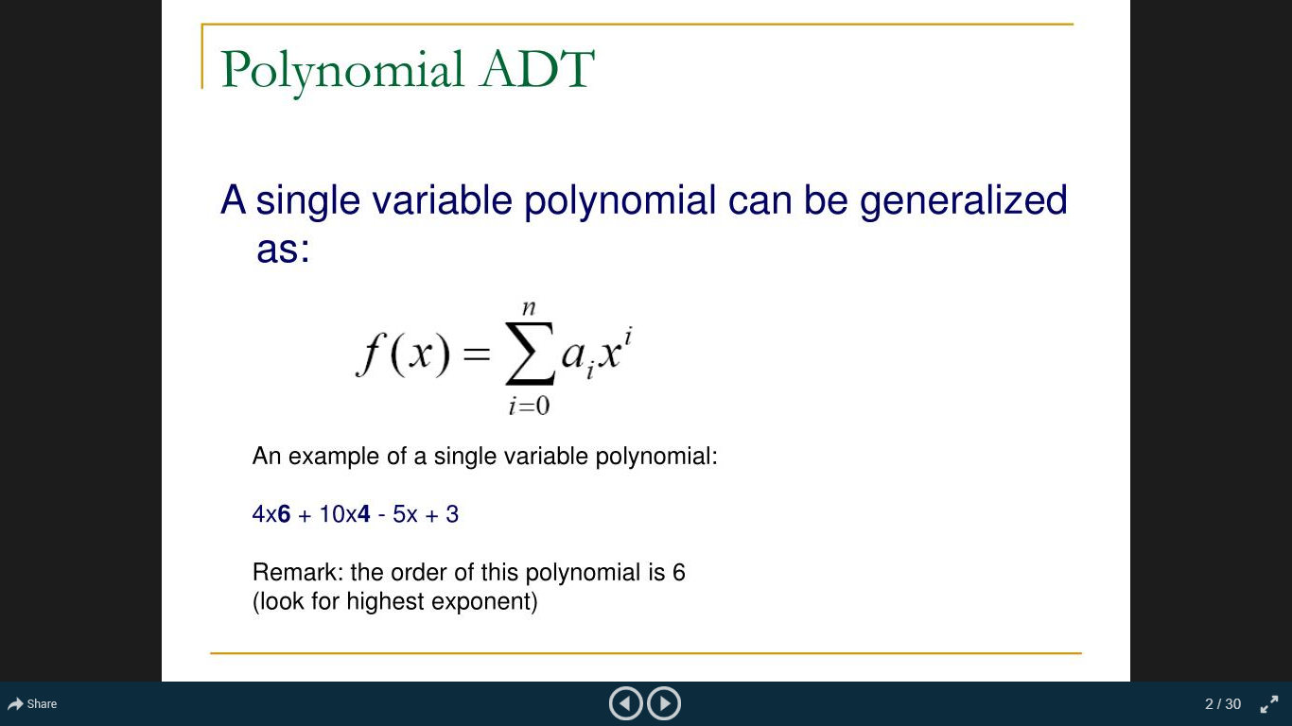

Slide 21
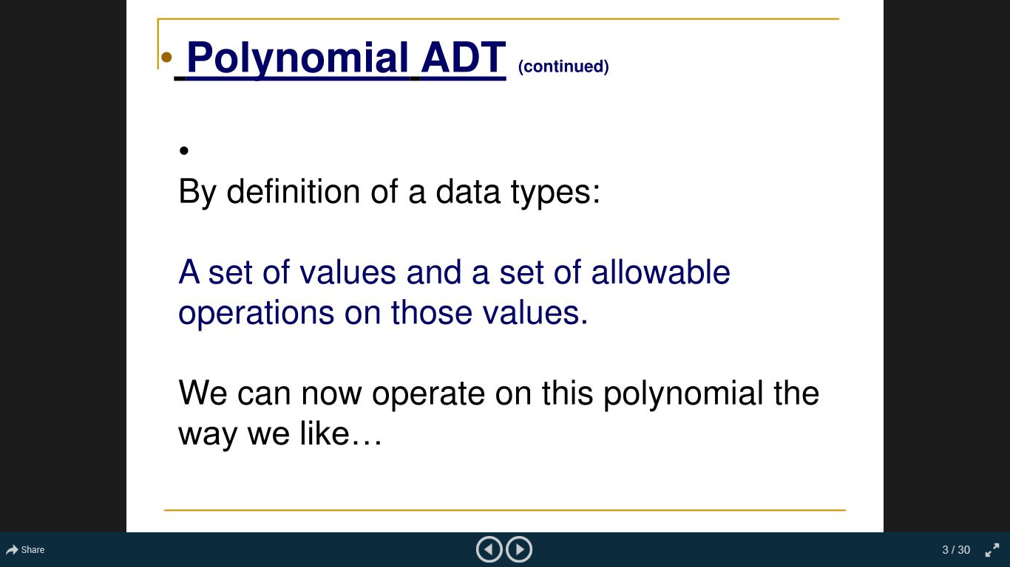

Slide 22
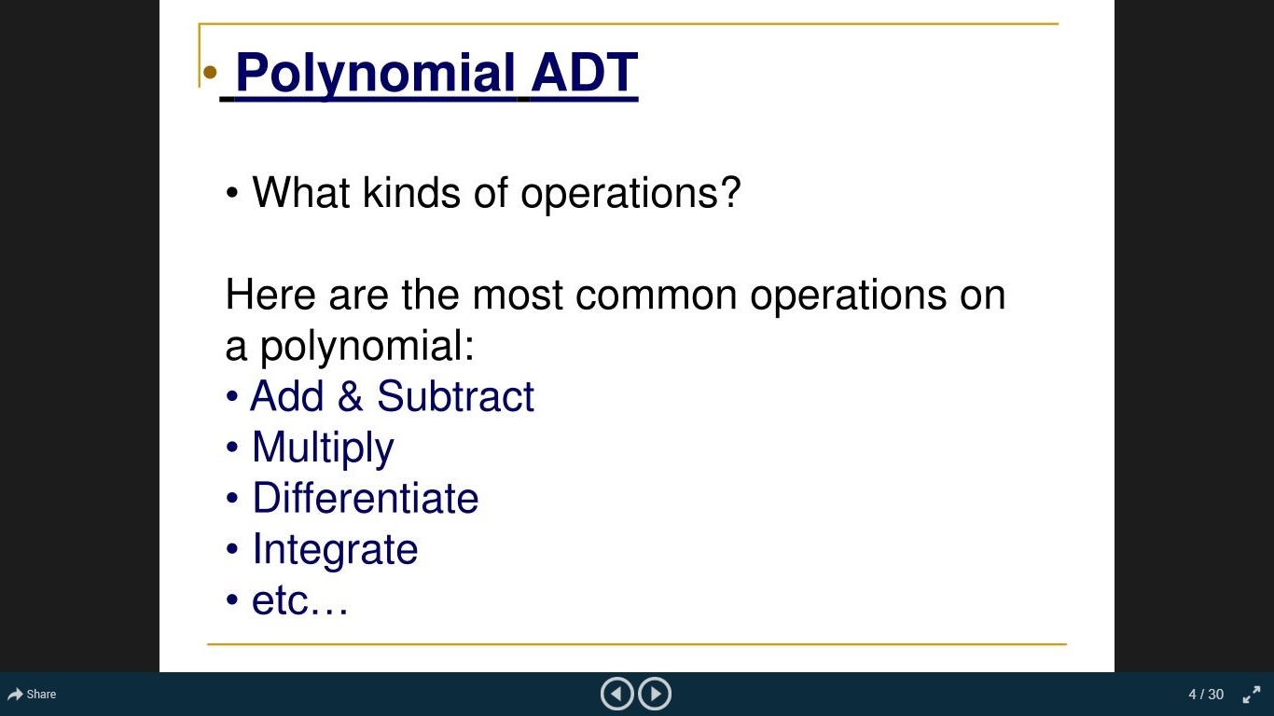

Slide 23
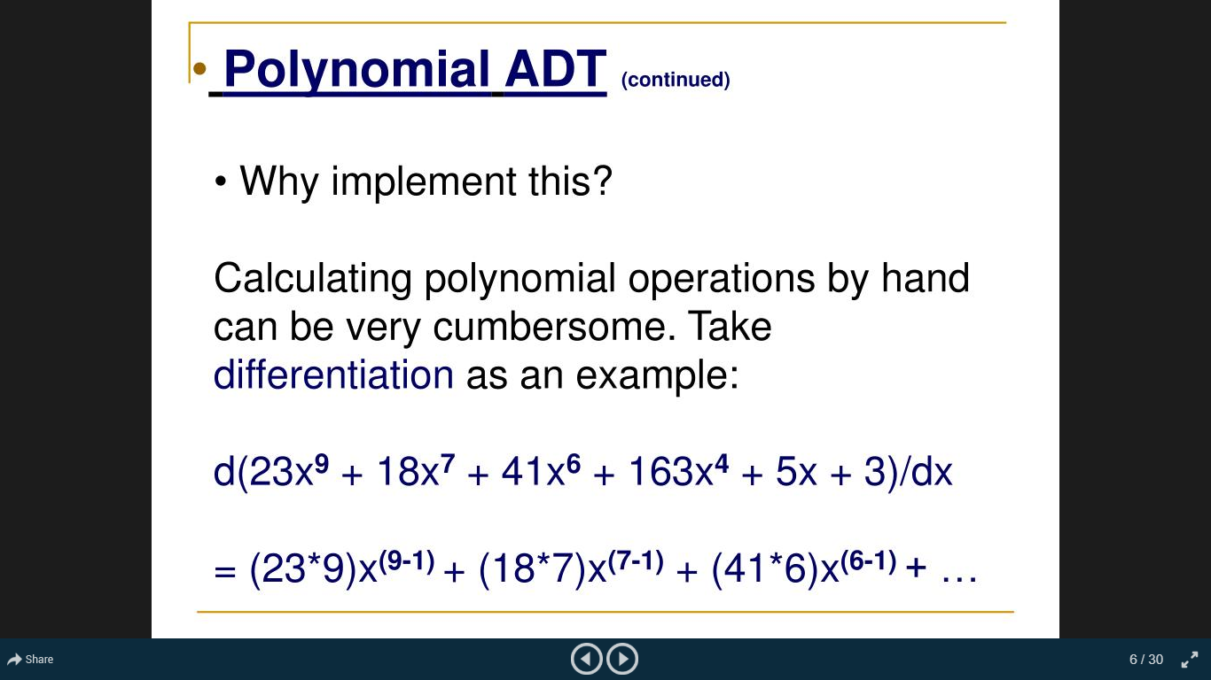

Slide 24
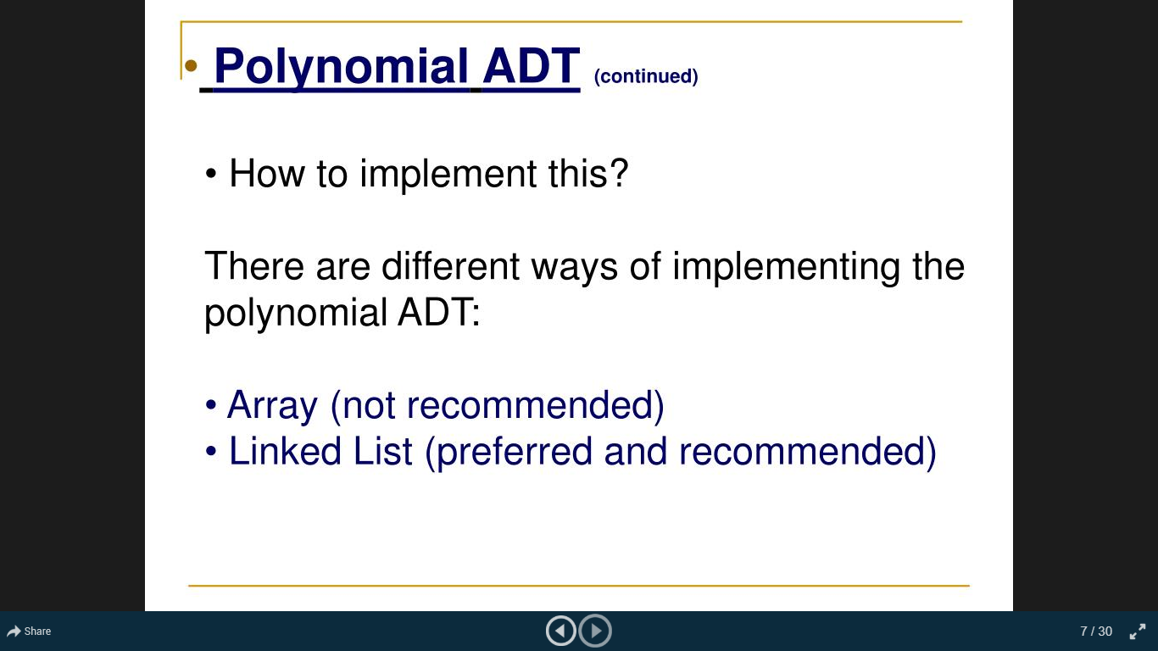

Slide 25
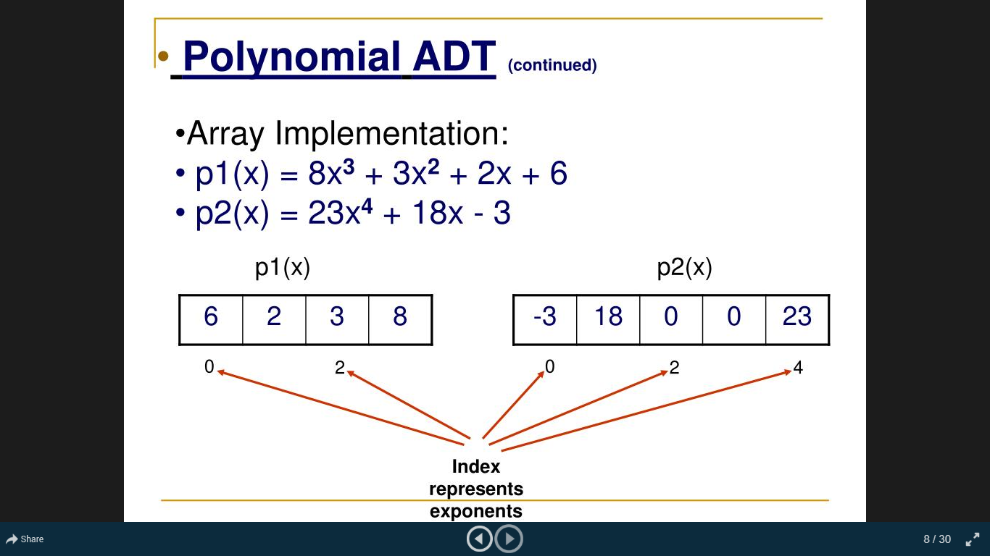

Slide 26
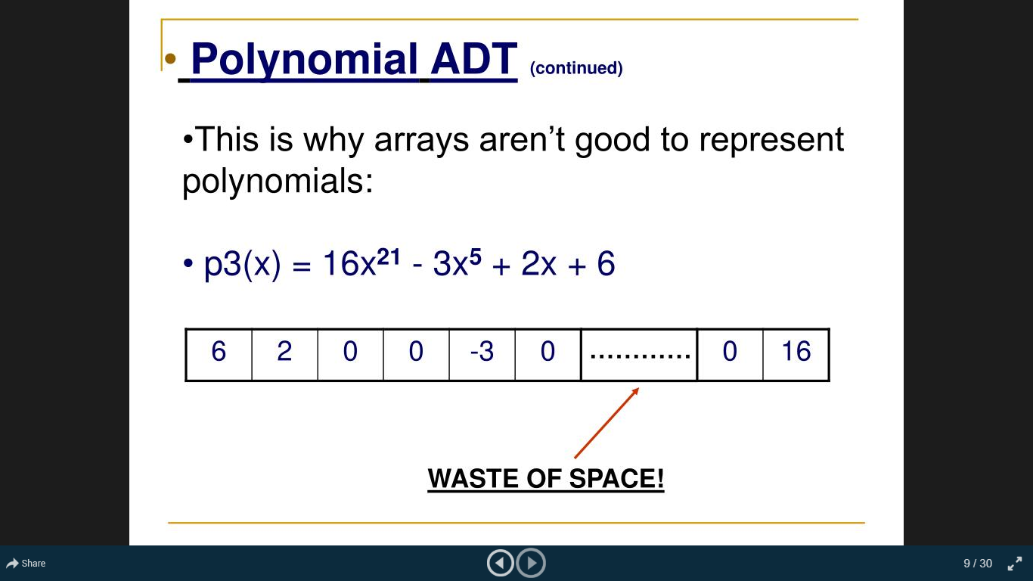

Slide 27
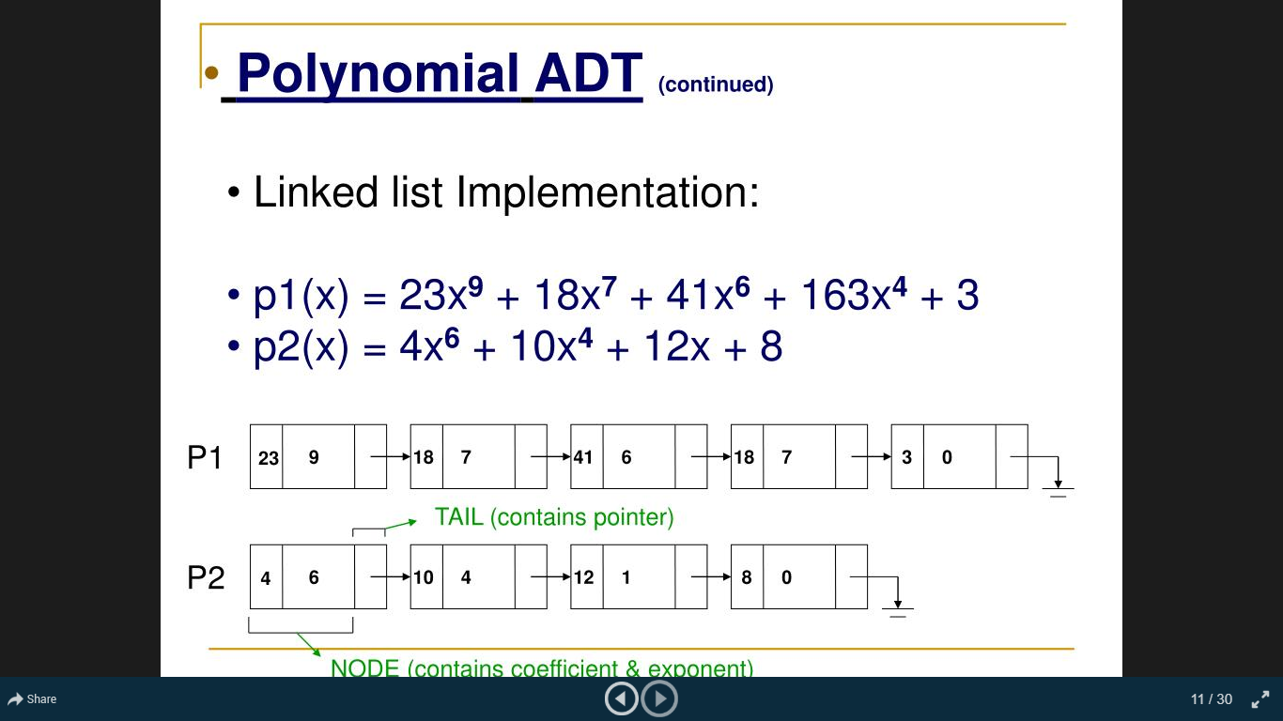

Slide 28
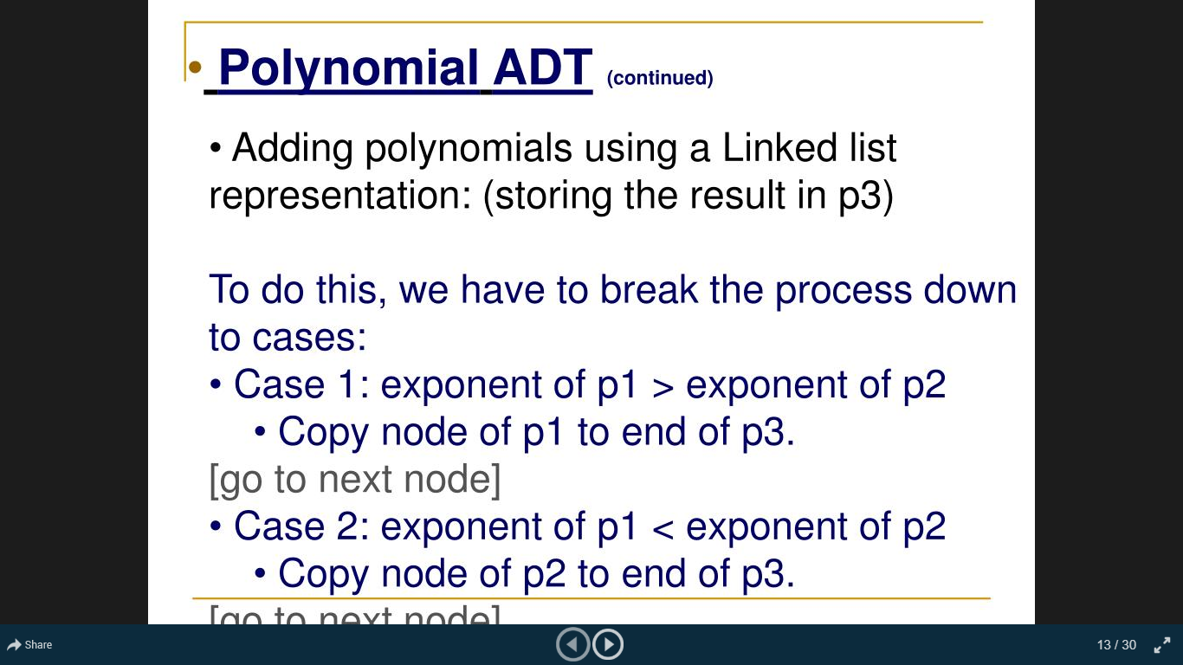

Slide 29
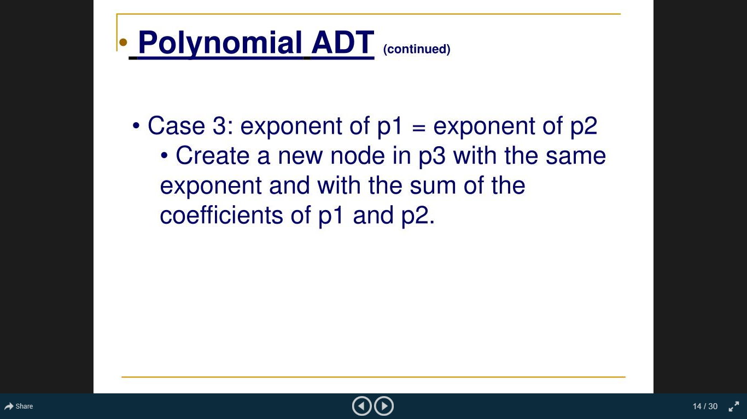

Slide 30
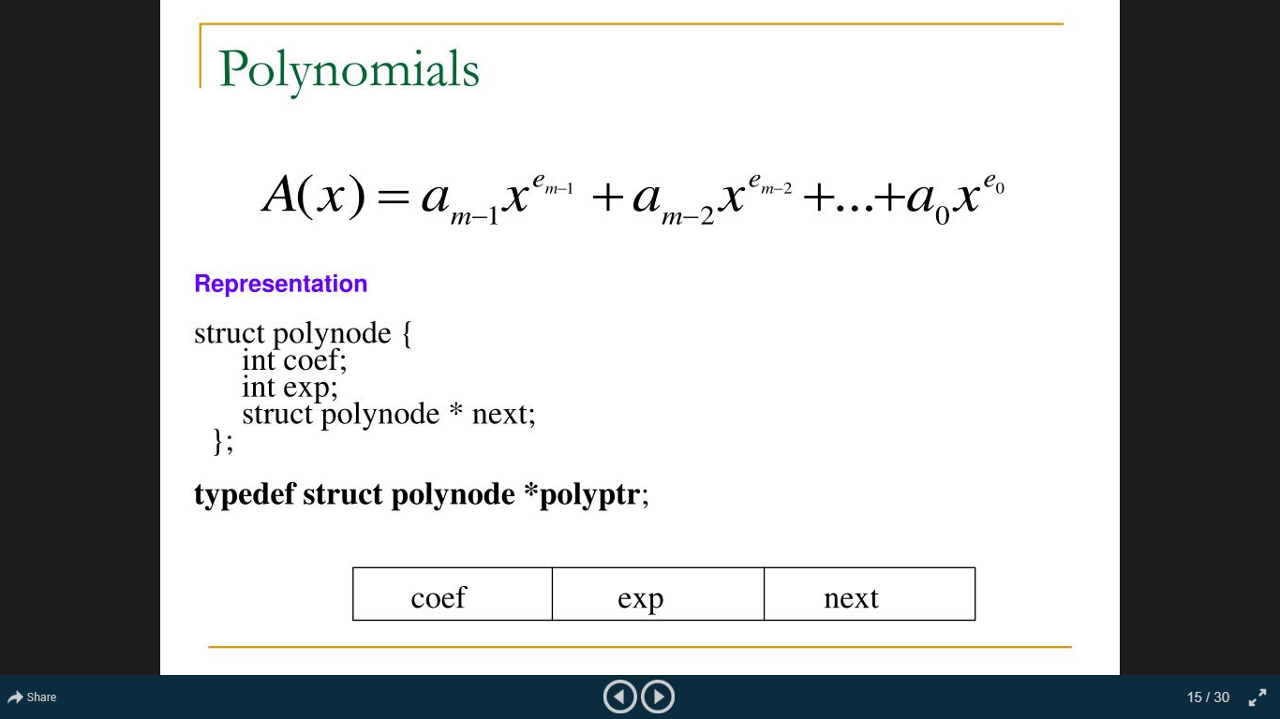

Slide 31
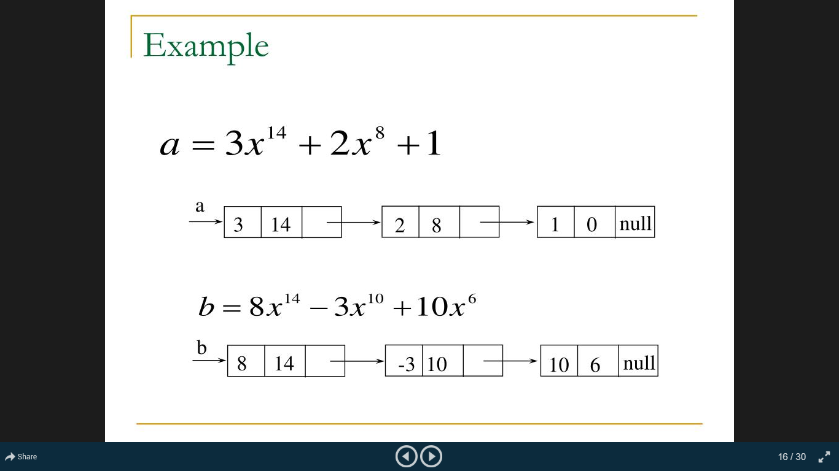

Slide 32
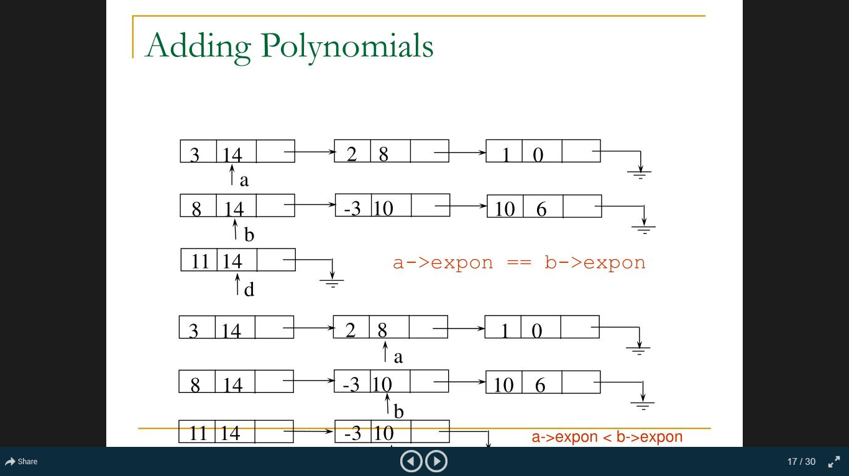

Slide 33
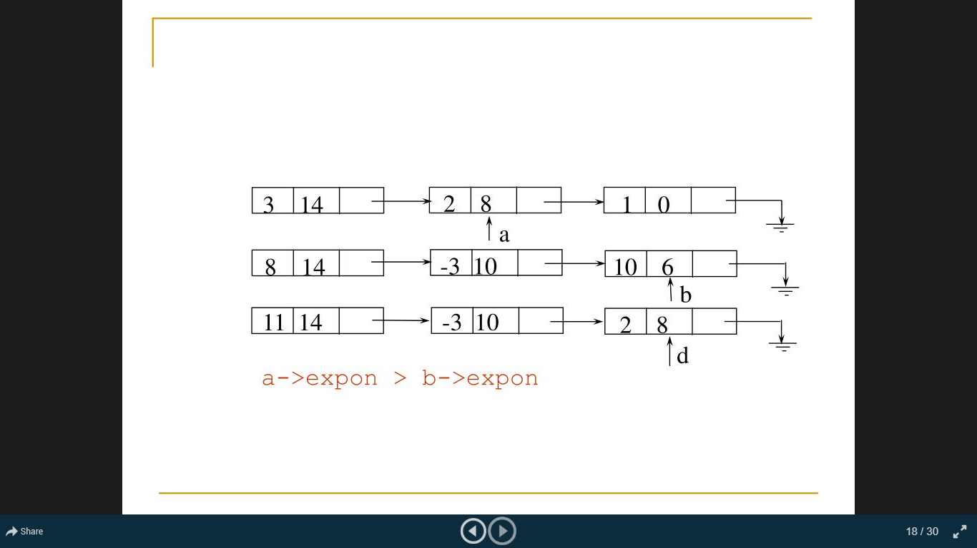

Slide 34
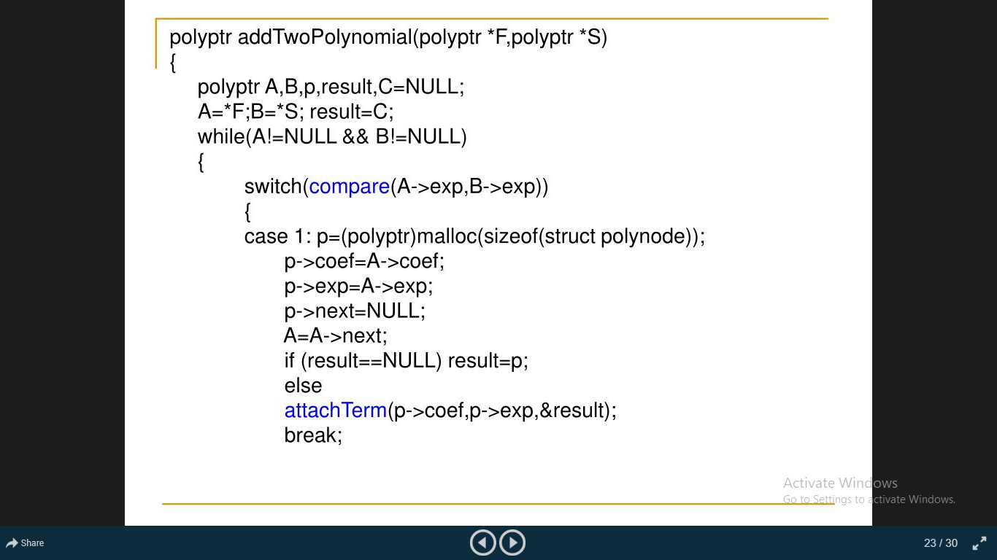

Slide 35
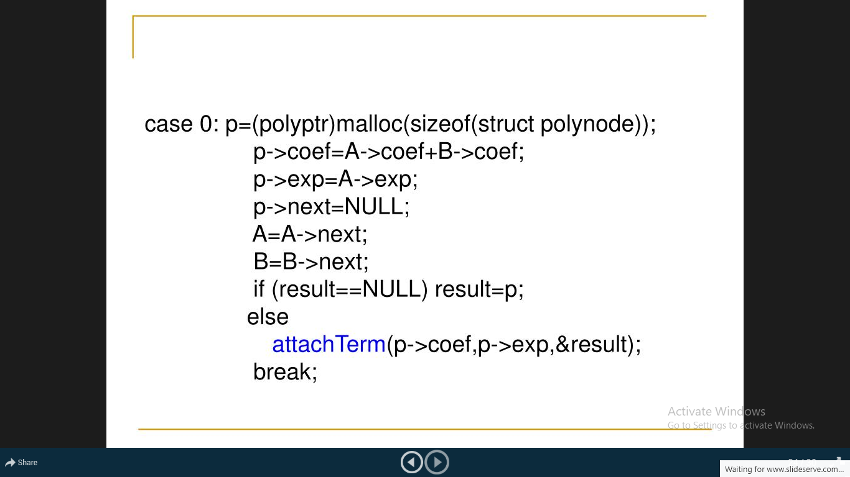

Slide 36
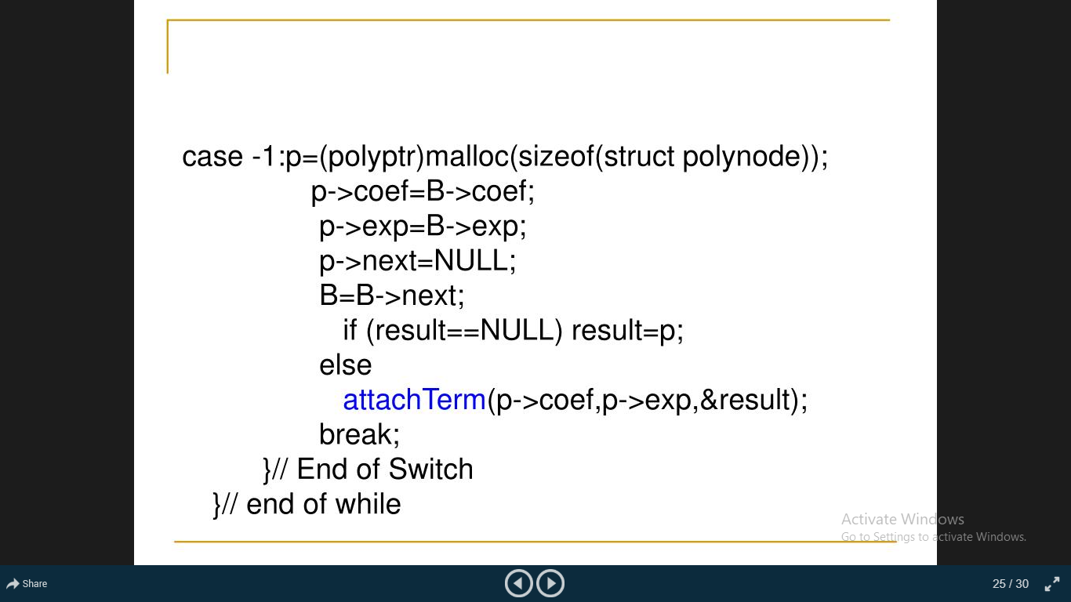

Slide 37
Tutorial Questions
Write algorithm for polynomial multiplication.
Write algorithm to represent sparse matrix using linked list.
Write algorithm to represent circular queue using linked list.

